Slide 1
Visualization Charts Presentation for
Flask Healthcare App
BAN 6420 Final Project (Programming in Python & R
By
Saheed Adebowale Badru
November 2025

Slide 2
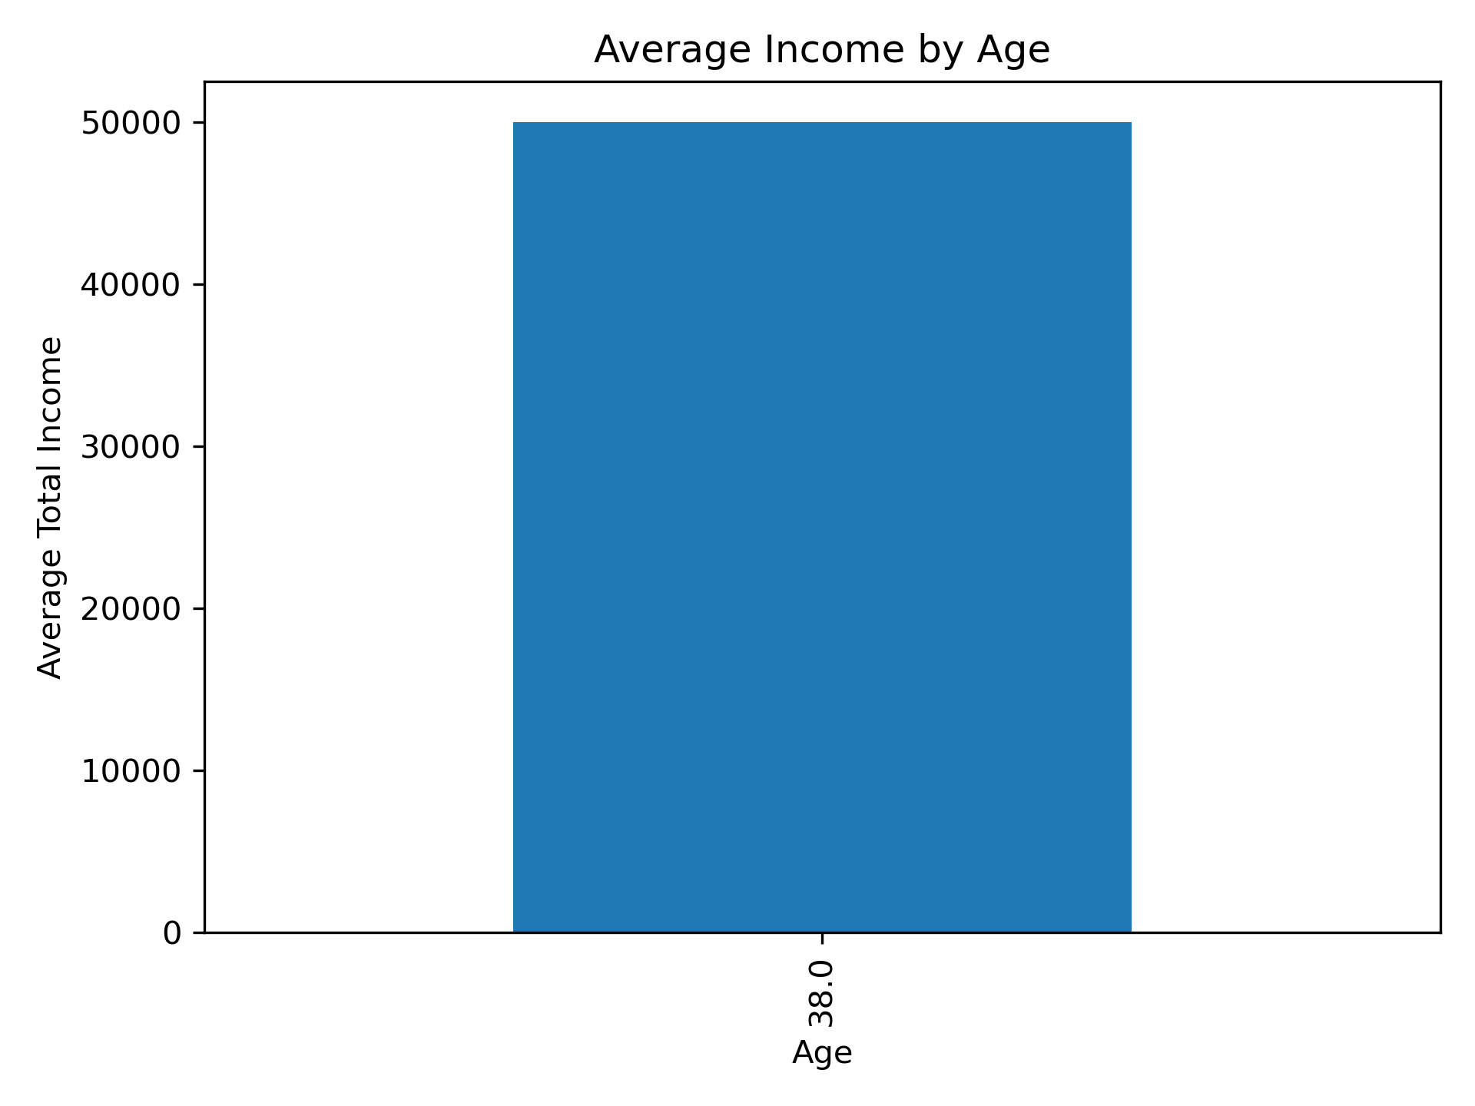
Average Income by Age
This chart shows how average monthly income varies across different age groups.
It highlights which ages tend to earn the highest income among the survey respondents. This helps identify income patterns and financial capacity across life stages.

Slide 3
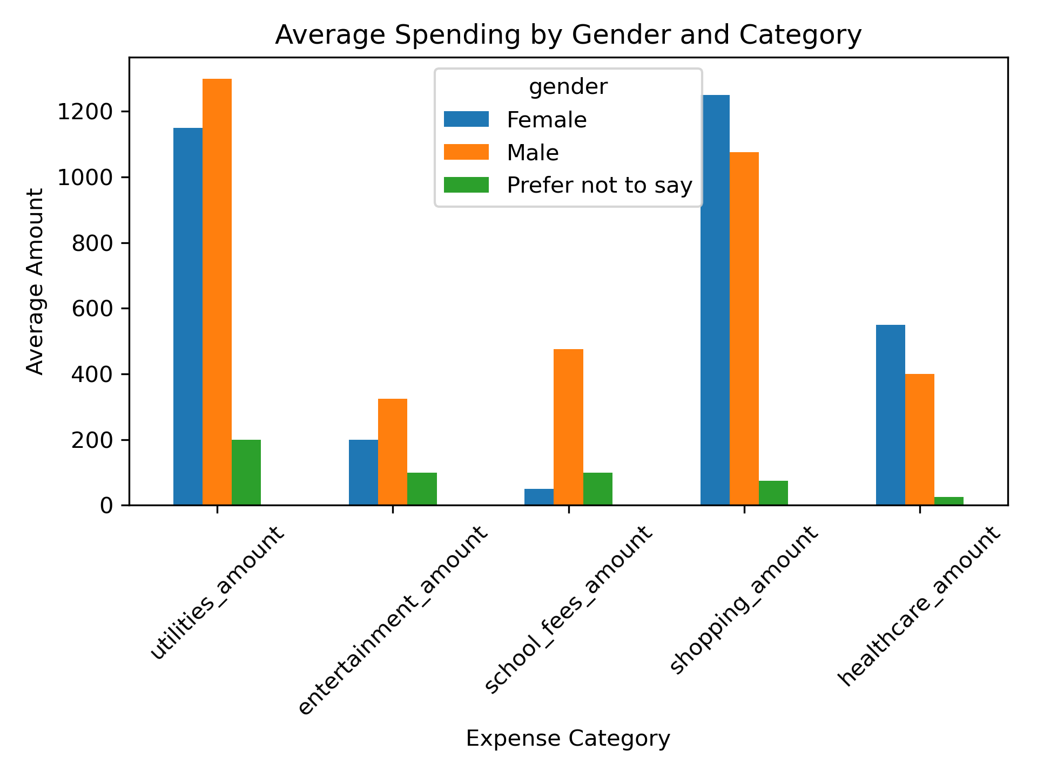
Average Spending by Gender Across Categories
This chart compares how different gender groups allocate their spending across key expense categories - utilities, entertainment, school fees, shopping, and healthcare.
It reveals spending trends and potential differences in financial behavior across genders.

